Slide 1
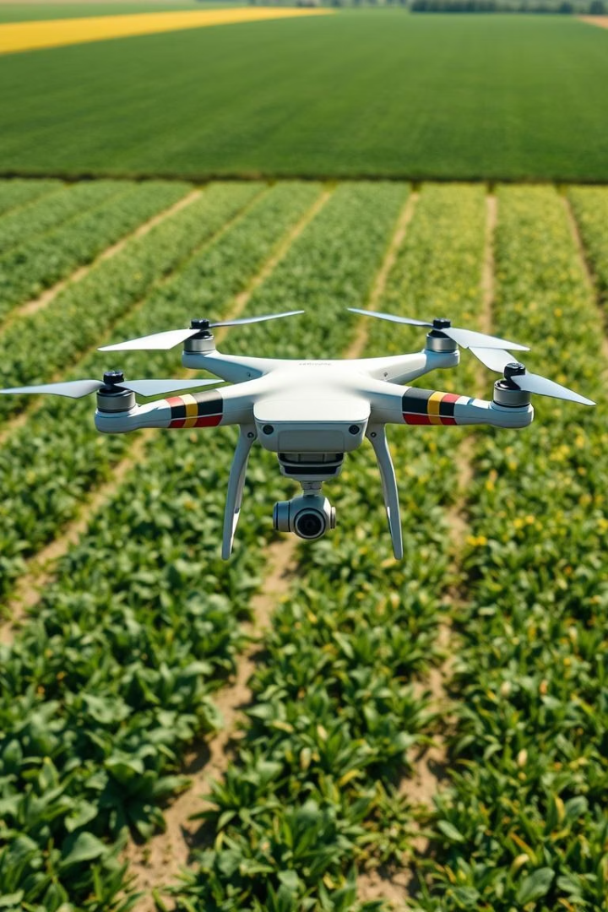

Detection of Crop Diseases Using UAV-Captured Images
This presentation explores an innovative approach to detecting crop diseases using unmanned aerial vehicles (UAVs) combined with classical machine learning techniques. Specifically, it leverages the Histogram of Oriented Gradients (HOG) for feature extraction from UAV-captured leaf images, followed by Principal Component Analysis (PCA) for dimensionality reduction and Logistic Regression for classification. The proposed method achieves high accuracy while sustaining computational efficiency, suitable for real-time deployment in agricultural monitoring.
This work aims to provide precise, scalable, and interpretable solutions for early disease detection supporting sustainable agriculture and global food security.
by SM Fazlur Rahman

Slide 2
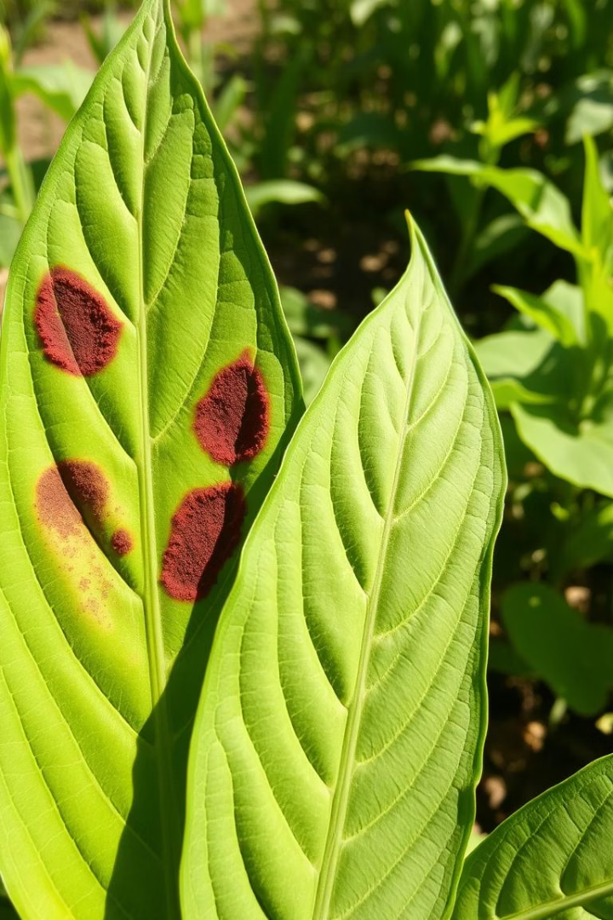
Introduction to UAV-based Crop Disease Detection
Crisis in Agriculture
Role of UAVs in Precision Agriculture
Plant diseases cause significant crop losses worldwide, threatening food security. Early detection is vital but traditionally relies on expert manual inspection, which is slow and labor-intensive.
Unmanned Aerial Vehicles enable rapid, large-scale acquisition of high-resolution images for crop health monitoring, providing a foundation for automated disease detection outside the limitations of manual scouting.
Our Approach
Using UAV images and machine learning pipelines leveraging HOG features and logistic regression offers a lightweight, interpretable, and efficient method for real-time disease diagnosis at leaf level.

Slide 3
Related Work and Feature Extraction Techniques
Traditional Machine Learning
Histogram of Oriented Gradients (HOG)
Popular in agriculture for disease recognition due to lower computational resources compared to deep learning. Utilizes handcrafted features like HOG, SIFT, and LBP combined with classifiers like k-NN, SVM, and Logistic Regression.
Effective for capturing texture and shape patterns in leaf images, highlighting disease symptoms such as spots and lesions. Converts images to gradient orientation histograms representing edge information, beneficial for interpretability and real-time use on UAVs.

Slide 4
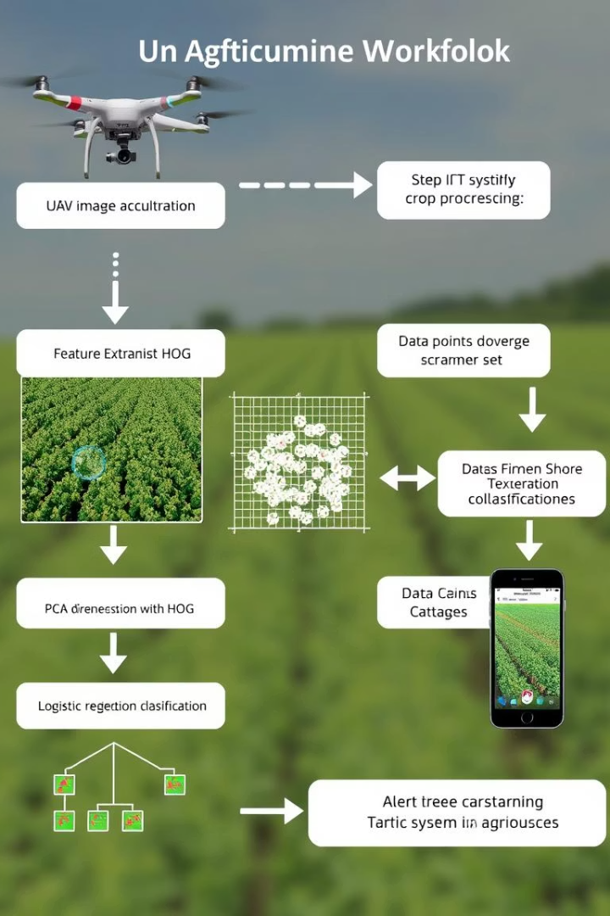




Methodology: System Architecture and Dataset
Image Acquisition
UAVs equipped with RGB cameras capture top-down images of agricultural fields to collect high-resolution leaf data.
Preprocessing
Uniform resizing to 128x128 pixels, grayscale conversion, dataset shuffling, and label encoding prepare data for analysis and ensure model robustness.
Feature Extraction & Classification
HOG descriptors extract rich features which are reduced via PCA to 2100 dimensions, followed by Logistic Regression for multiclass disease classification.
Alert Mechanism
System sends notifications with geolocation data to farmers for real-time disease mitigation and precision intervention.

Slide 5
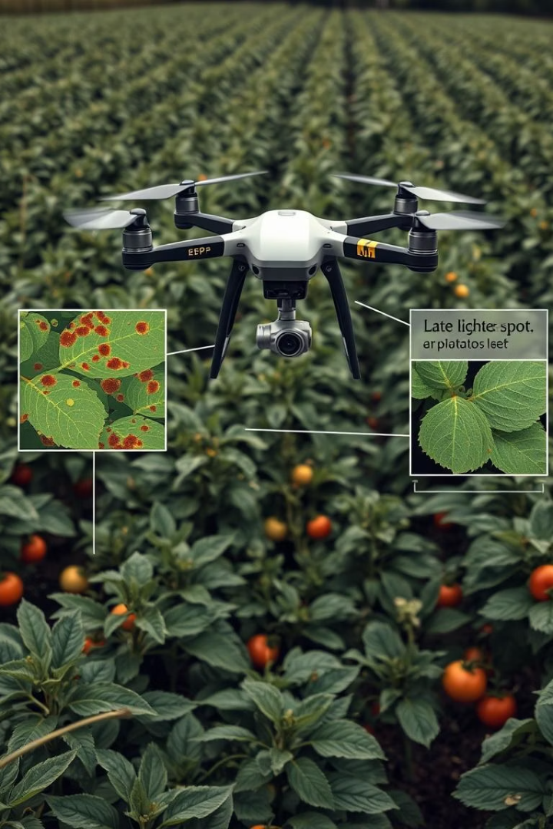
Experimental Setup and Test Cases
Disease Class
Samples
Data Split
Pepper Bell - Bacterial Spot
249
Training 75% / Testing 25%
Potato - Late Blight
250
Training 75% / Testing 25%
Tomato - Late Blight
478
Training 75% / Testing 25%
Images from the PlantVillage dataset were randomized and preprocessed before feature extraction. Each test image was passed through the pipeline to validate classification efficacy for multiple disease types.

Slide 6
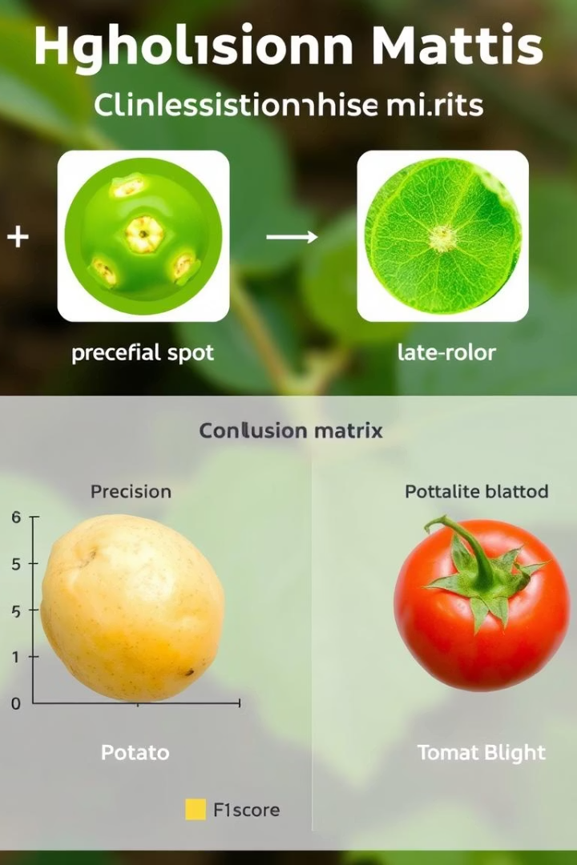
Results and Performance Analysis
88.02%
0.88
Overall Accuracy
Average F1-Score
High performance on multiclass crop disease detection from UAV images.
Strong balance between precision and recall across diseases.
2100
Features After PCA
Dimensionality reduction maintained key variance for classification.
Individual class results show balanced precision and recall, demonstrating the system’s ability to handle similar diseases effectively.

Slide 7
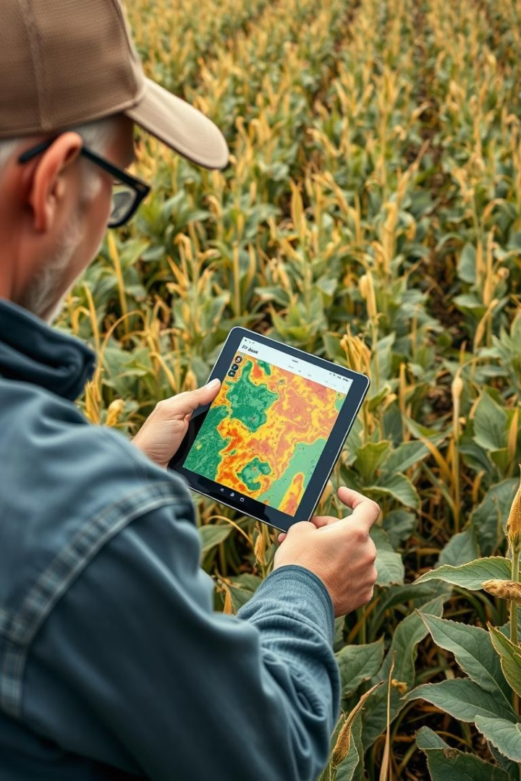
Discussion: Strengths and Challenges
Strengths
Challenges
Lightweight, interpretable model suitable for embedded UAV platforms.
Visual similarity between some diseases complicates classification accuracy.
Effective handcrafted features reduce dependency on large datasets.
Limited dataset classes restrict wide applicability without broader data.
Modular pipeline enabling easy upgrades and scalability.
Environmental variations affect image quality and feature robustness.
Mitigation Strategies
Dimensionality reduction via PCA reduces computational costs.
Stratified sampling improves balanced performance evaluation.
Future model optimisation planned for real-time UAV deployment.

Slide 8
Conclusion and Future Work
Conclusion
Future Directions
The proposed system showcases a practical, scalable approach for timely crop disease diagnosis using UAV imagery and classical machine learning. It achieves high accuracy with efficient computation, suitable for resource-constrained real-time scenarios.
Incorporate deep learning models (CNNs, Transformers) to enhance accuracy.
Expand to multi-crop, multi-disease datasets for comprehensive coverage.
Real-time onboard processing on edge devices like NVIDIA Jetson Nano.
This work supports sustainable agricultural practices by enabling early intervention and reducing losses.
Environmental robustness via image augmentation for variable lighting conditions.
Integration with IoT and mobile applications for farmer-centric decision support.
Geotagging for spatial disease mapping and proactive management.

